Slide 1
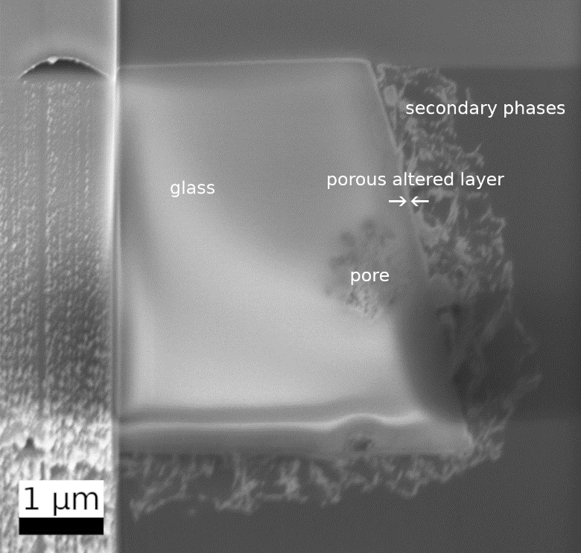
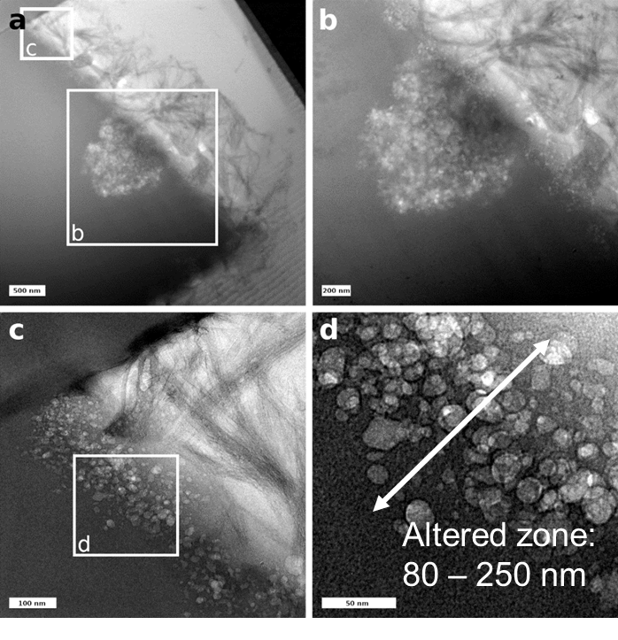
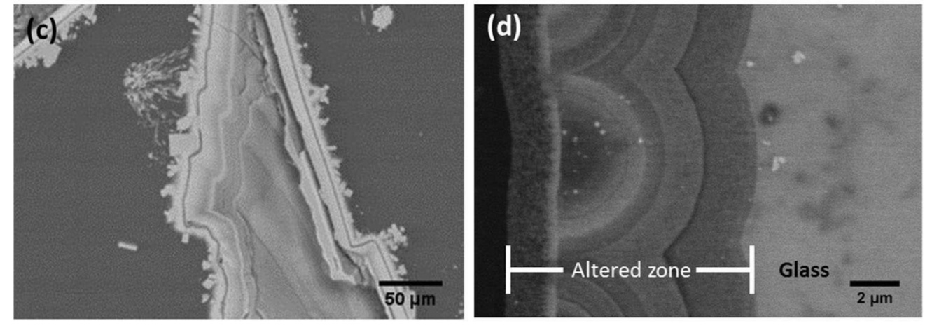
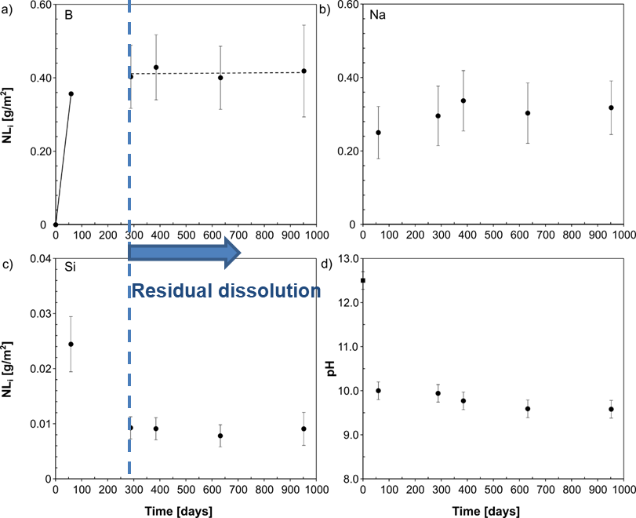
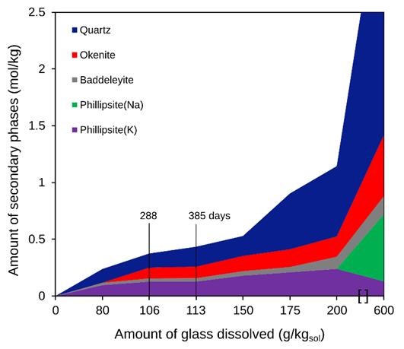
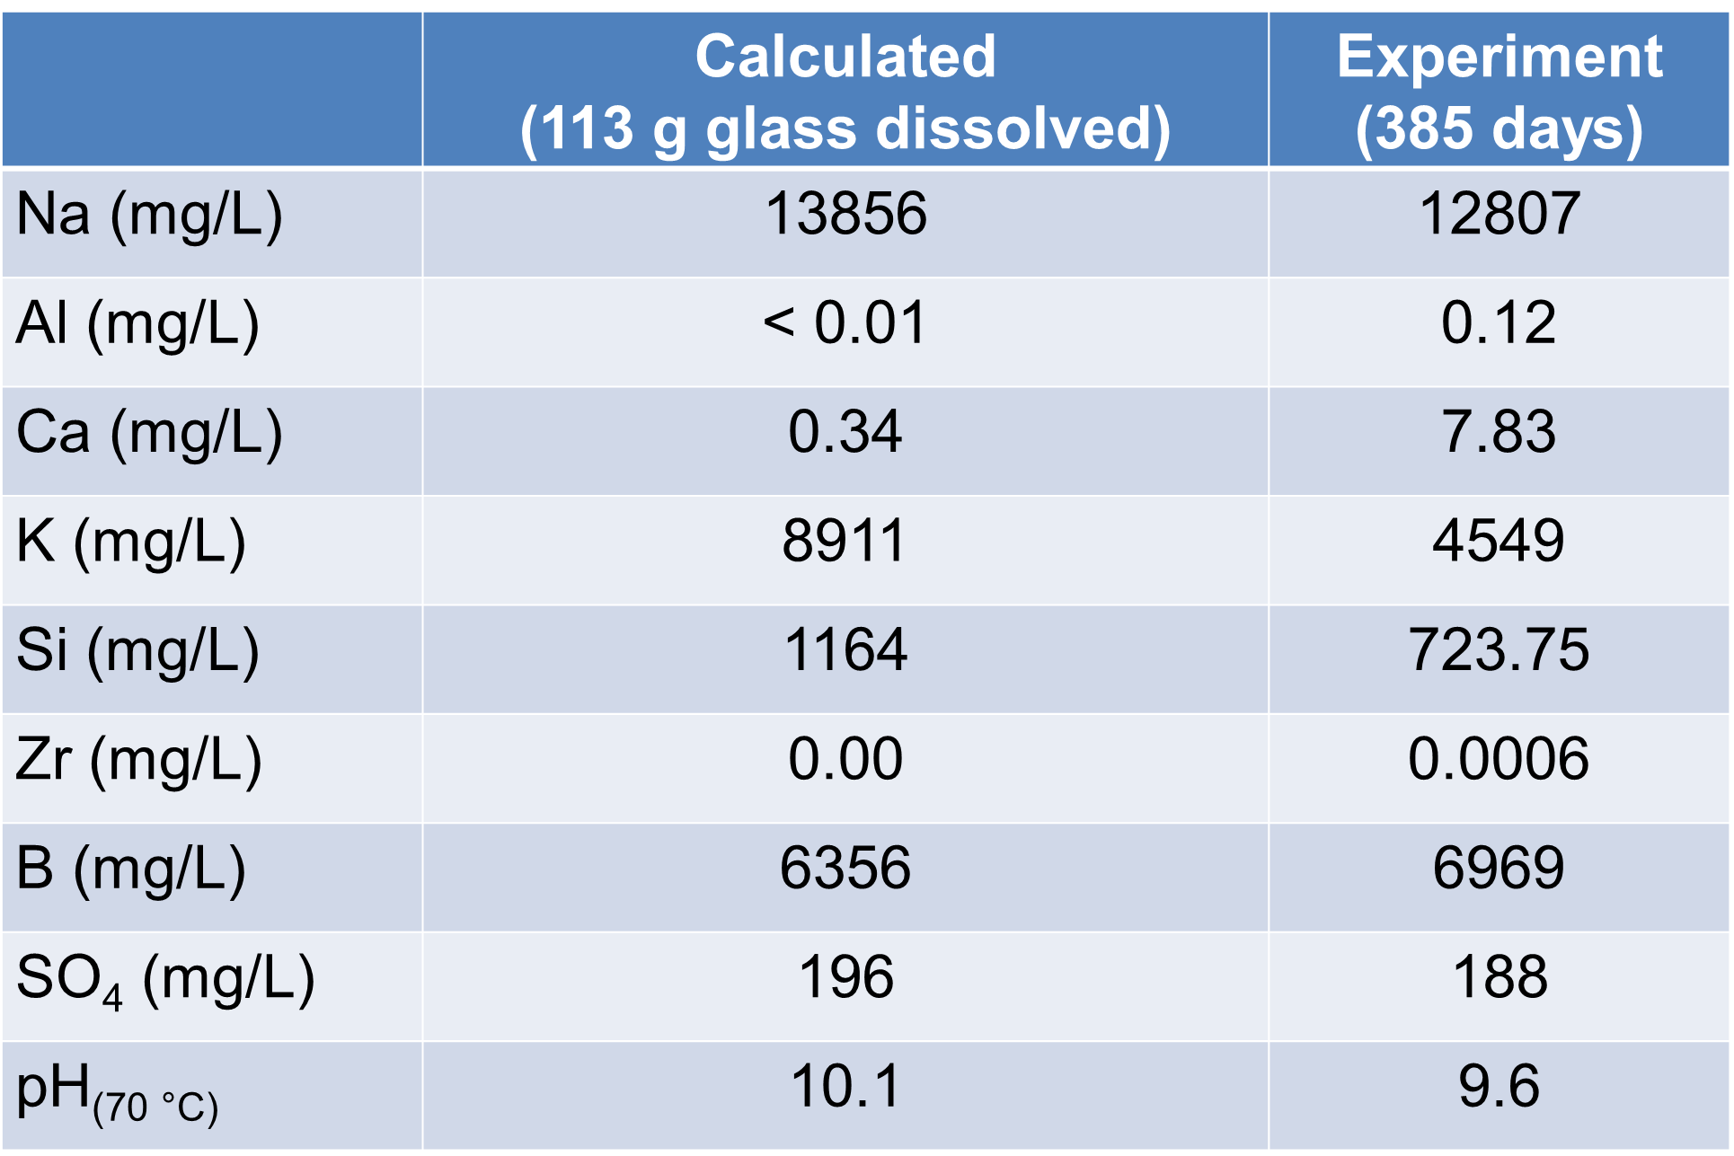
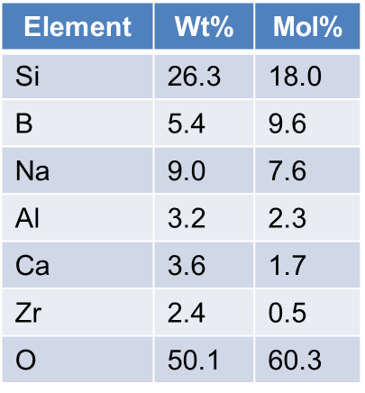
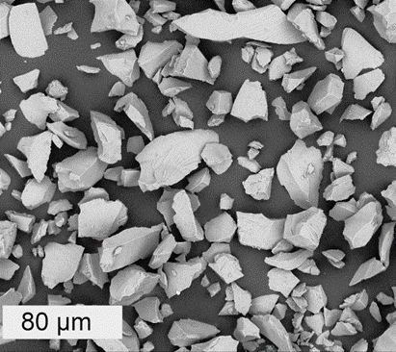
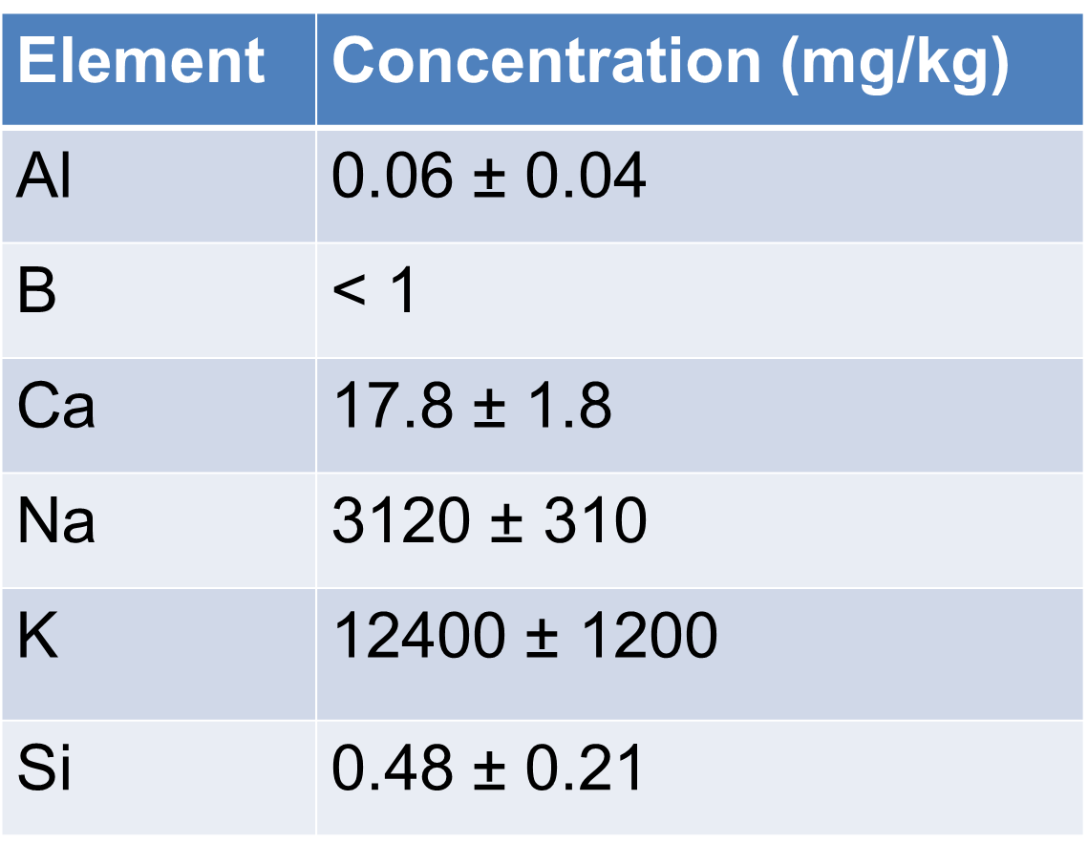
Dissolution of simplified nuclear waste glass (ISG) and
formation of secondary phases
Felix Brandt¹, Martina Klinkenberg¹ , Sébastien Caes², Jenna Poonoosamy¹, Wouter Van Renterghem³, Juri Barthel ⁴, Karel Lemmens², Dirk Bosbach¹, Karine Ferrand²
¹Institute of Energy and Climate Research (IEK-6), Nuclear Waste Management and Reactor Safety, Forschungszentrum Jülich GmbH, 52425 Jülich, Germany; f.brandt@fz-juelich.de
²Institute for Environment, Health and Safety, SCK CEN, B-2400 Mol, Belgium; ³Institute for Microstructural and Non-Destructive Analysis, SCK CEN, B-2400 Mol, Belgium
⁴Ernst Ruska-Centre (ER-C 2), Forschungszentrum Jülich GmbH, 52425 Jülich, Germany
Introduction & Objectives:
Results:
Leaching mechanism = selective removal of cations
Still state-of-the art for waste management agencies but under debate in the scientific community
Identification of secondary phases (XRD + SEM)
Zeolites (Na and K zeolite)
Calcium silicate hydrate phases (CSH)
Microscopic perspective, residual stage:
the glass/SAL interface (TEM), SA/V = 264000 m⁻¹
Very thin porous altered layer, no colloids
Structure resembles a bubble foam
Fibrous secondary phases
relationship with the cavities of the porous layer?
SA/V = 8300 m⁻¹
Mann et al., 2019, ISG glass in YCWCa @70 °C
Gel layer of multiple colloidal bands
Sharp boundaries between layers
Crystalline phases formed around the outer edge
Summary and Conclusions:
SA/V ratio is a key parameter for the dissolution rate and the formation of the altered glass surface and secondary phases at high pH conditons.
Macroscopic element release NL_{i} and residual dissolution rate of 6 x 10⁻⁶ g/m²d in a usual range
No resumption although secondary phases are formed
Thermodynamic blind predictions can predict the observed secondary phases, some phases are missing due to kinetic reasons
CSH phases and zeolites confirmed by SEM, XRD or TEM. Stable phases such as K-zeolite present as well as metastable Na-zeolite and CSH of a kinetically controlled composition.
The unusual microstructure: very thin, porous layer from which CSH phases appeared to have grown
→ Competition between dissolution/re-precipitation of secondary phases and formation of a leached layer
Gin et al., 2013
Mann et al., 2019
15 µm
Models based on the proposed leaching mechanism are mainly based on macroscopic experiments at low surface area to volume (SA/V) ratio (e.g. Frugier et al., 2018)
Details of surface alteration layer (SAL) formation?
Formation of new phases and incorporation of RN?
Relevant experimental conditions e.g. high pH, low T due to the presence of concrete and cement?
Macroscopic perspective
Normalized element release NL_{i} = amount of glass (g/m²) dissolved at a given time calculated from the element release. NL_{i} and residual rateof 6 x 10⁻⁶ g/m²d in the usual range
Thermodynamic equilibrium calculation based on mass balance of dissolved elements (NL_{i})
Blind prediction: All cations released end up in secondary phases, if they are supersaturated.
➔ The microscopic view
Effect of high pH
Morphology and properties of altered phase?
Type of newly formed secondary phases?
Lower temperature
More difficult to form crystalline secondary phases?
Slower dissolution of the glass?
Higher SA/V
More secondary phase formation?
Predicted and observed
Zeolite
CSH (Okenite)
Not observed due to kinetics
Quartz
Baddeleyite
Materials and Methods:
ISG
YCWCa
Batch experiments at high pH and high SA/V
Modelling of thermodynamic equilibria (GEMS-PSI)
Estimation of secondary phase equilibrium assuming congruent dissolution and precipitation
Sample taken from day 385
Sample embedded in resin
Polished to obtain a cross-section
FIB section prepared perpendicular to the polished surface
References:
Frugier, P. et al 2008. J. Nucl. Mater. 380, 8–21. DOI: 10.1016/j.jnucmat.2008.06.044
Gin, S. et al. 2013. Mater. Today 16, 243–248. DOI: 10.1016/j.mattod.2013.06.008
Mann, C. et al. 2019. npj Mater. Degrad. 3, 5. DOI: 10.1038/s41529-018-0059-9
Characterization of the solid
Separation of crystalline secondary phases
XRD of separated grain size fractions
Electron microscopy: SEM, FIB, TEM

